Slide 1



EDA
Hotel booking

Slide 2

Presented By -
Sejal Thakur
Pratiksha Bhise
Guided By -
Abhishek Wavhal

Slide 3
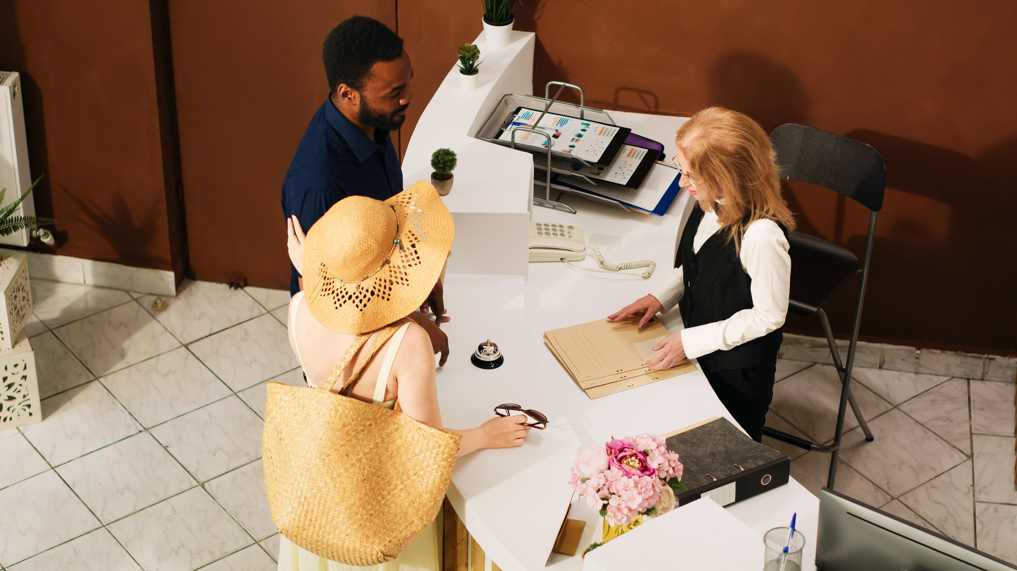
Project Summary
This dataset encompasses booking information
for both city and resort hotels, detailing variables such
as the booking date, the number of adults,
children, and babies, the availability of parking spaces,
and the booking agent, among other attributes.
Objective:
The aim of this project is to explore
and analyze the dataset to uncover key factors
that influence hotel bookings.
Task:
Analyze and visualize the booking data for the
City Hotel and Resort Hotel to gain insights into
the various factors affecting bookings and the
Average Daily Rate (ADR).

Slide 4
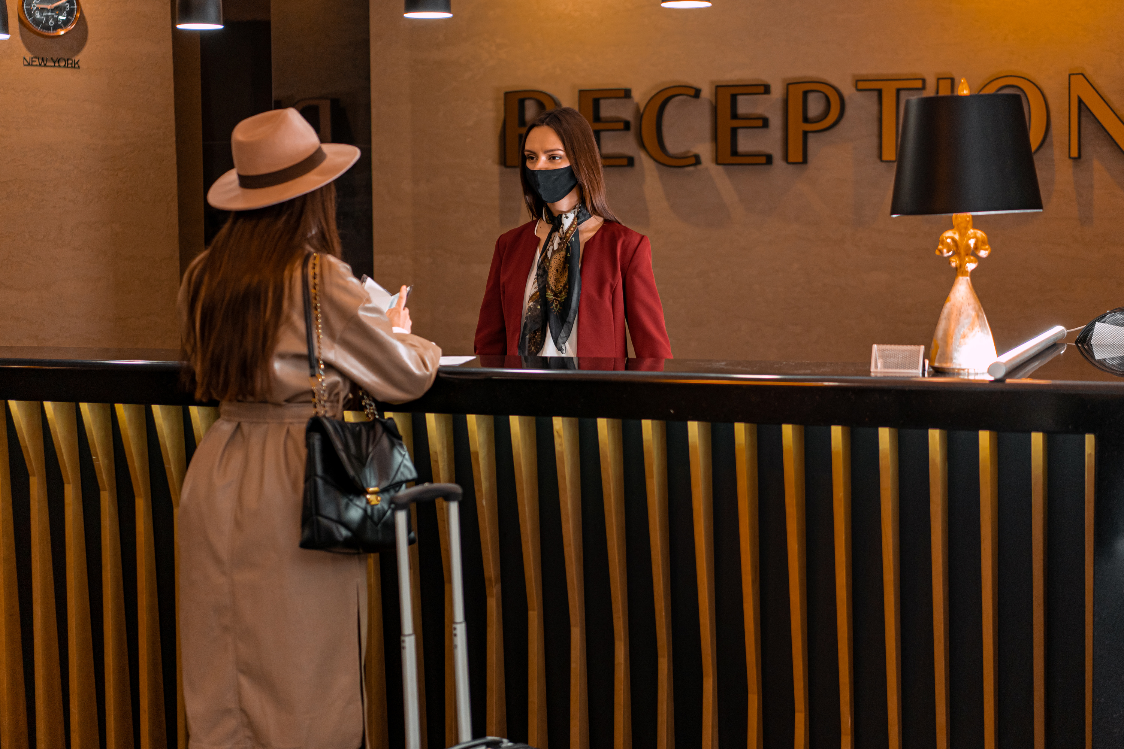
Data Overview
1. The given dataset is of Hotel Booking and we have
to analyse and explore this dataset to discover important factors
which affects the Hotel Booking.
2. This dataset has 119390 rows and 32 coulumns.
3.The duplicate value count is 31994 rows.
4.There are 4 columns in dataset which is having missing
valuse and those columns are company, agent, country and children.
5. There are separate columns called adults, children and
babies that show the total number of people who are coming
to visit, so instead of different columns will add these
three in one called total_num_people
6.There are separate columns called stays_in_weekend_nights
and stays_in_week_nights that show the total stay time people
who are coming to stay, so instead of different columns will add
these two in one called total_stay

Slide 5
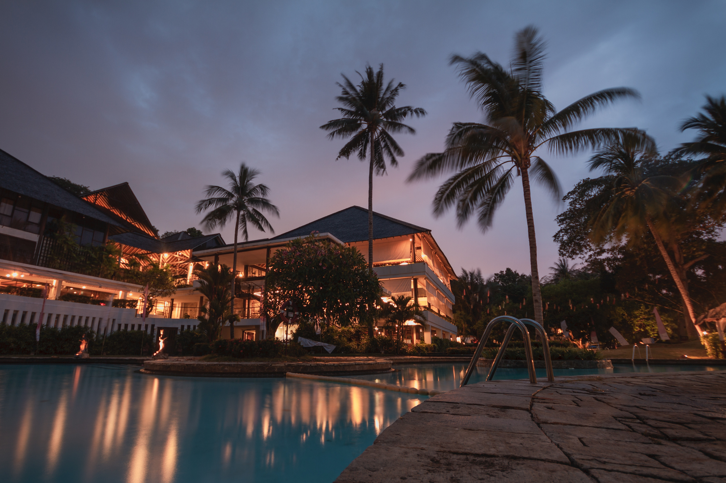
The Establishments
Resort Hotel
City Hotel
2000 - 2010
2011 - 2018
2019 - 2024
A presentation is a formal talk, often delivered in front of an audience, aimed at conveying information, persuading others, or sharing insights on a particular topic. Presentations can take various forms, such as verbal speeches, slideshows, demonstrations, or multimedia displays.
A presentation is a formal talk, often delivered in front of an audience, aimed at conveying information, persuading others, or sharing insights on a particular topic. Presentations can take various forms, such as verbal speeches, slideshows, demonstrations, or multimedia displays.

Slide 6
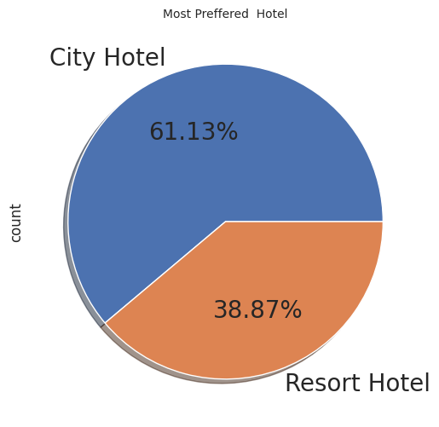

Number of peoples book resort hotel and city hotel?
The majority of people, accounting for 60.84%, prefer staying in city hotels, while the remaining 39.16% opt for resort hotels
Hence we can see according to the analysis that more people prefer the City hotel over the Resort Hotel.

Slide 7
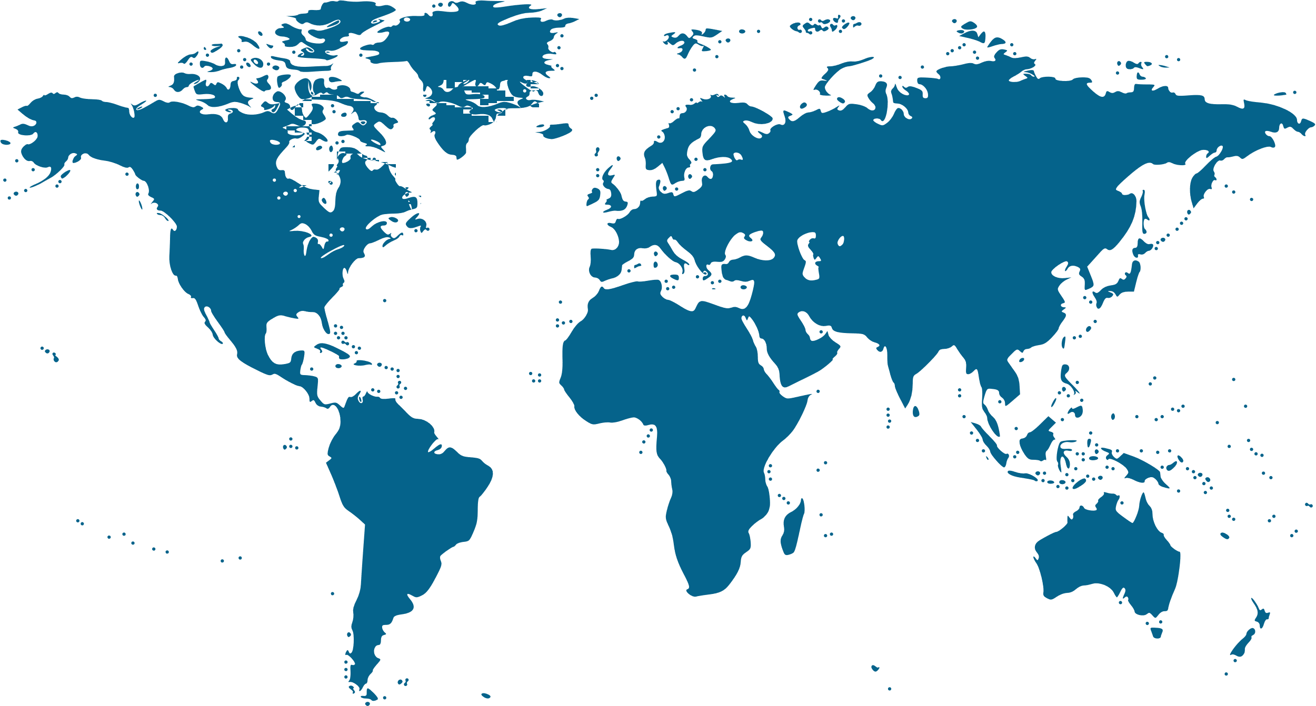

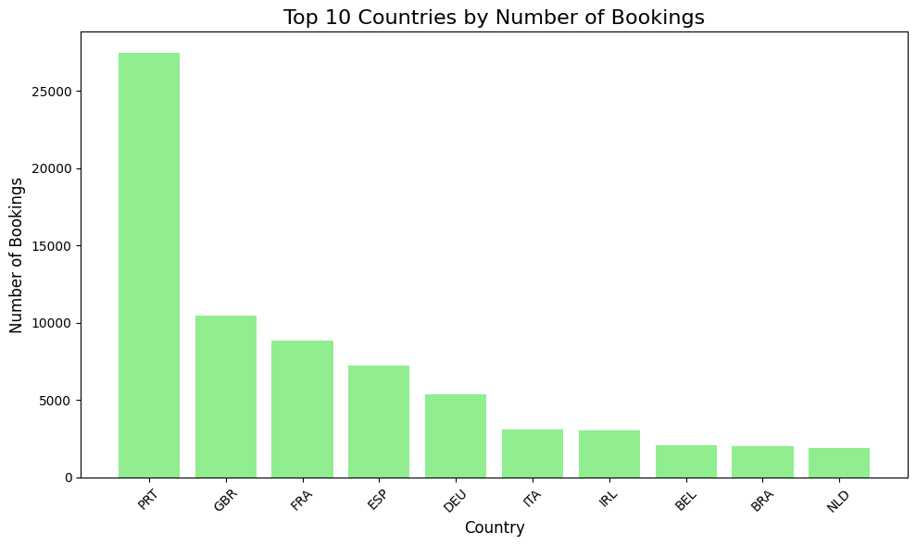
2. from which country we have getting more bookings?
•The highest booking is from Portugal (PRT) country
•Portugal has made the highest number of booking
in resort hotels
Portugal (PRT) leads with 27,453 bookings, highlighting strong
local demand and the significance of domestic travelers in the
dataset. Hotels could focus on enhancing offerings for this key market.

Slide 8

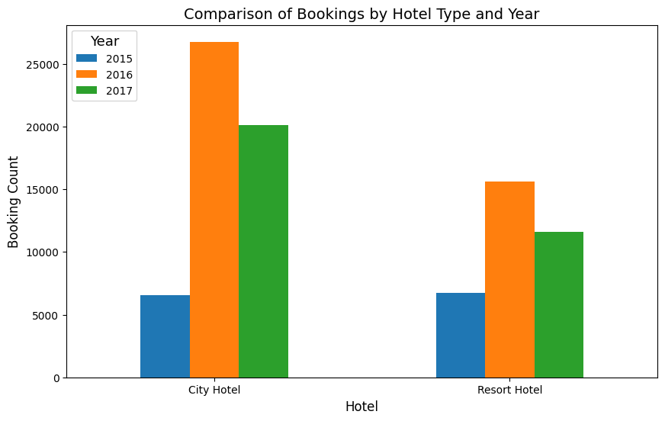
3. Which year had highest bookings[ City hotels or Resort Hotels ]
This chart shows that 2016 had the
highest number of bookings for both
City and Resort Hotels
compared to the three years of
hotel booking data.
Analysis of Booking Data (2015-2017)
Observation: In 2016, both City and Resort Hotels experienced the highest number of bookings
compared to the other two years (2015 and 2017).
Implication: The spike in 2016 indicates a notable increase in popularity and demand for hotel
bookings during that year.

Slide 9
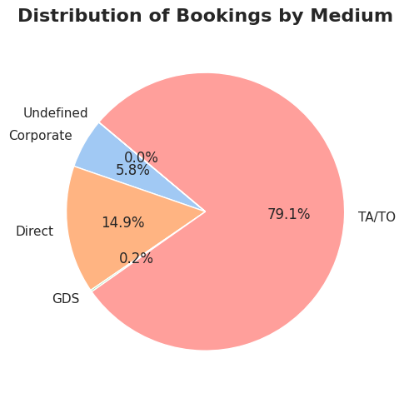
4.from which kind of market we are getting more booking?
The majority of bookings were made through the TA/TO (Travel Agents/Tour Operators) channel,
accounting for a total of 69,141 bookings.
This highlights the significant reliance on
intermediaries like travel agents or tour operators in driving hotel bookings.

Slide 10

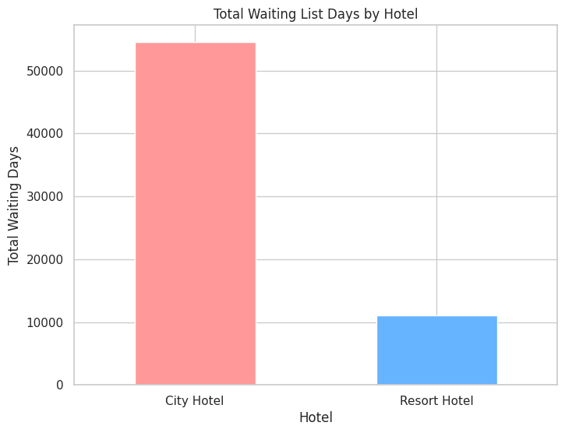
5. Which hotel has most waiting list of guests
The analysis reveals that city hotel has the highest total waiting days,
indicating city hotel has the longest guest waiting list. This can highlight operational
inefficiencies or high demand periods. Addressing this issue might help
improve guest satisfaction and booking management.

Slide 11
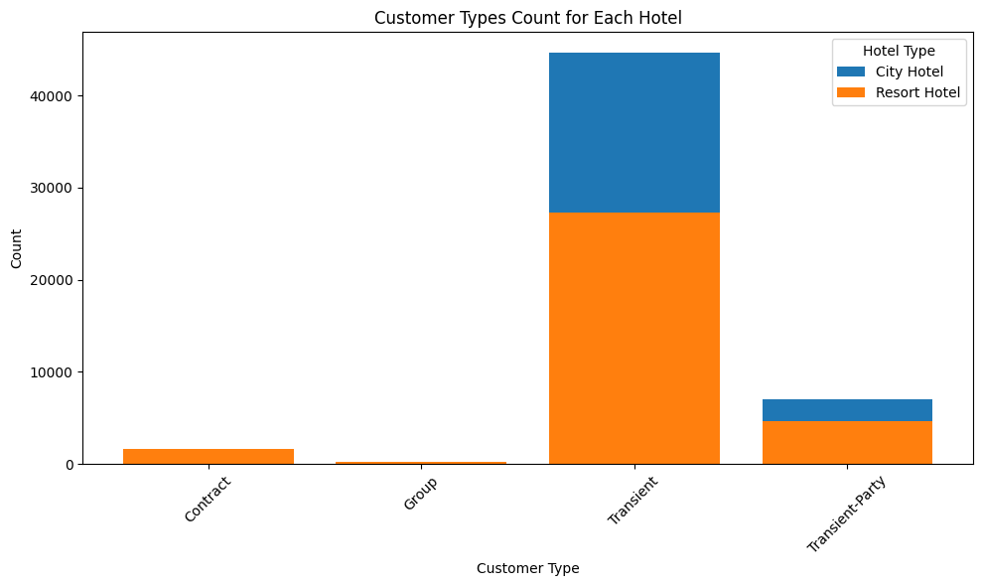
6. Types of customers visiting the two types of hotels
Transient Customers :
Largest segment for both hotels.
City Hotel: 43,675 bookings;
Resort Hotel: 26,718 bookings.
Transient-Party Segment:
More bookings at City Hotel (6,910) than Resort Hotel (4,589).
Contract Customers:
Low for both;
Resort Hotel slightly higher (1,635 vs. 1,415).
Group Customers:
Smallest segment with similar numbers;
City Hotel: 263, Resort Hotel: 261.

Slide 12
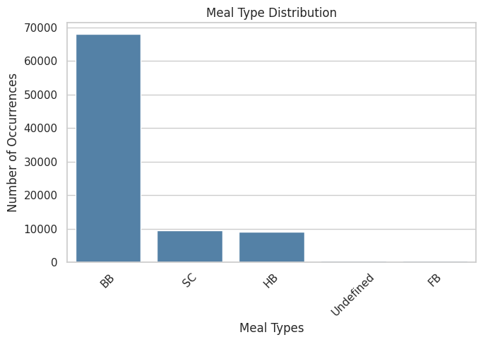
7. Which is most preferred food type?
BB (Bed & Breakfast): Most popular meal plan, chosen by 66,506 customers, likely due to flexibility and affordability.
SC (Self-Catering): Second most preferred (9,226 bookings), appealing to budget-conscious or independent travellers.
HB (Half-Board): Moderate preference (8,889 bookings), suitable for customers seeking convenience without full commitment.
Undefined: Minimal (487 bookings), possibly due to missing data or custom arrangements.
FB (Full-Board): Least chosen (358 bookings), as fewer travellers opt for all-inclusive packages.

Slide 13
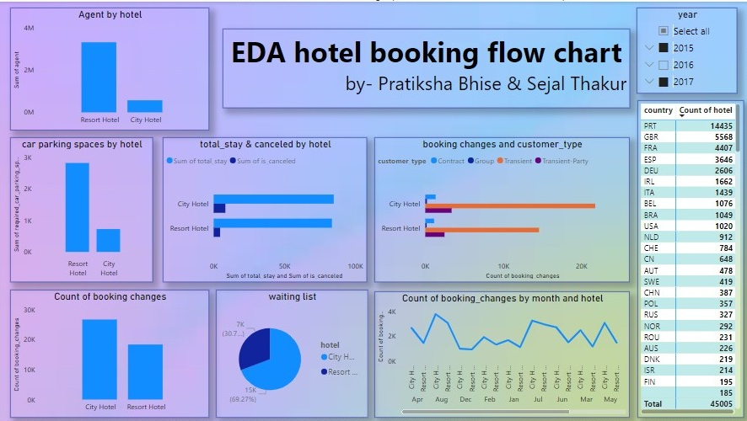

Slide 14


